Slide 1
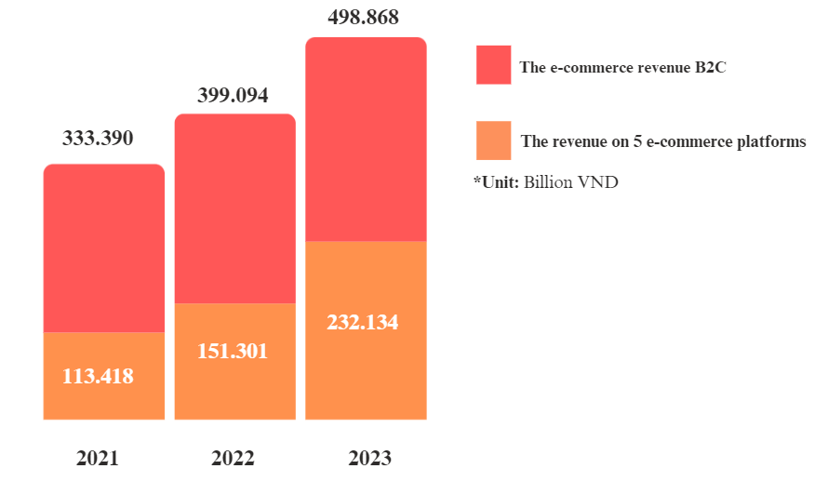
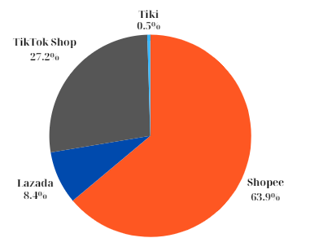
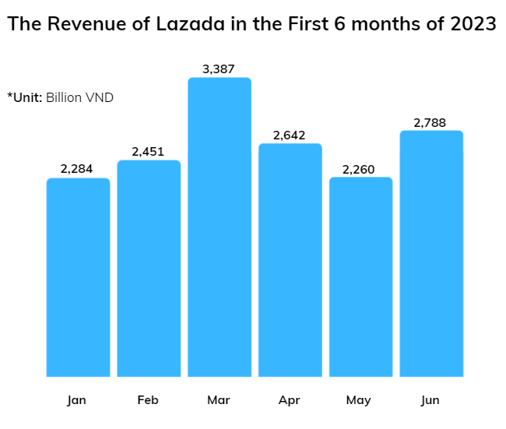


Industry Structure
Vietnam is the second largest market in Southeast Asia (second only to Indonesia)
Lazada is one of the giants in e-commerce of Southeast Asia.
B2B2C is Lazada's current business model.
The current biggest competitor is Shopee.
TikTok Shop also have a tend to ovecome.
The First Quarter of 2024

Slide 2

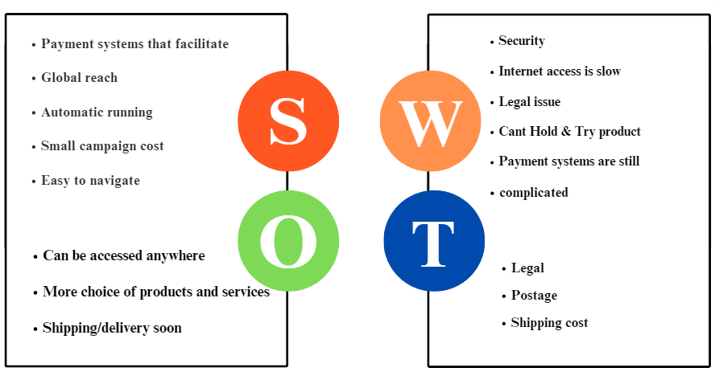
Strategy Competitor
Lazada's vision is to accelerate development for Southeast Asia.
With the mission of Bringing the world to Southeast Asia.
Create an ecosystem to "To make it easy for anyone to do business anywhere"
Lazada is applying The Differentiation Strategy
focusing on providing good customer experience.
diverse and quality products/services.
Good customer experience:
Easy-to-use web interface and application.
Professional customer service and 24/7 support.
Safe and convenient payment system.
Provides a variety of products:
Cooperates with many reputable sellers.
Strictly controls product quality.

Slide 3

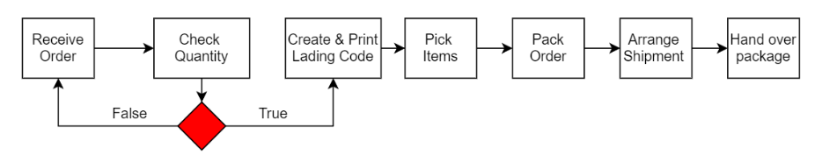
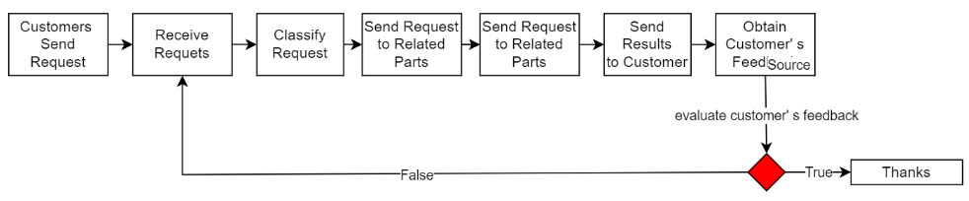
Value Chain
The 2 most important processes:
To serve the above competitive strategy, our team will choose: Operation and Customer Service
Inbound logistics: managing the import of goods from suppliers into Lazada's warehouse.
Operations: managing orders warehouses, and product supply for customer satisfaction within Lazada's internal operations.
Outbound logistics: Transporting goods from Lazada's warehouse to customers post-order placement.
Sales/marketing: Advertising and marketing products to attract customers and boost sales.
Service customer: Providing after-sales customer support services encompassing user manuals, technical support, and returns and complaints processing.
Operation Process:
Customer Service Process:

Slide 4

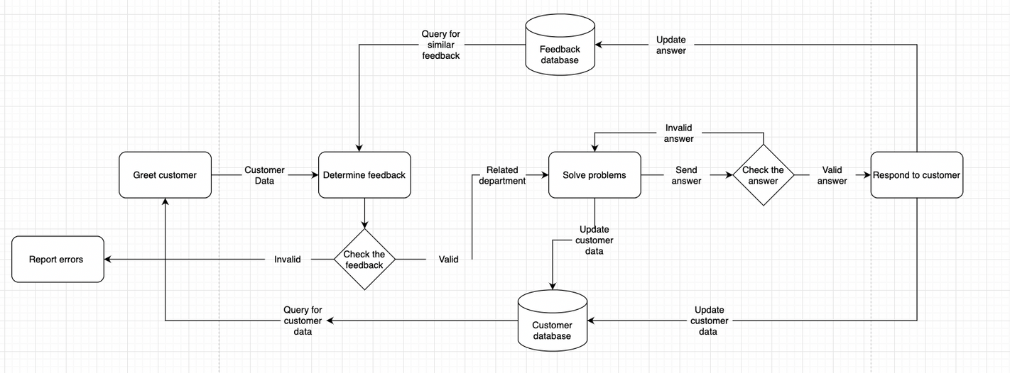
Business process
The business processes of the Lazada e-commerce platform include:
- Ordering process.
- Return process.
- Employee management process.
- Customer data management process.
- Customer feedback process.
- Inventory management process.
The most importance thing:
The "Customer Feedback"
-Build close relationships with customers: to helps create trust and loyalty from customers.
-Grasp the needs and desires of customers: to understand what customers expect and thereby provide suitable products/services.
-Optimize product/service delivery process: to identify the strengths and weaknesses of the service, thereby continuously improving and developing.

Slide 5
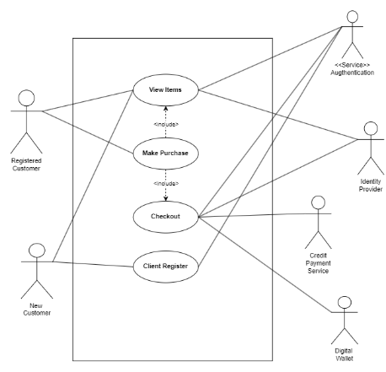
Analyze Information System
Software:
Hardware:
End devices
Storage devices
Hardware security
Human:
Have passion for work and in-depth knowledge.
Able to adapt to changes of the times.
-> Is an important factor contributing to creating a Lazada

Slide 6
Process:
Suggestion
To make a difference, the “Reply to customers” process highlights Lazada's competitive strategy, which is also the key to building sustainable relationships with customers.
*Suggestion 1: Utilizing VR and AR technology
-Impact on users: helping them be more confident in choosing products.
-Influence on Lazada's strategy: helps Lazada create a difference and attract customers.
Data (*Most Important):
Lazada may collect the following personal data:
-Identity data - Contact data,
-Account data - Transaction data
-Technical data - Profile data
-Usage data - Location data
-Biometric data
-Marketing and communications data.
*Suggestion 2: Research and deploy new payment methods:
-Impact on users: the experience will be faster, safer and more convenient payments.
-Influence on Lazada's strategy: create trust and attract customers.
*Data is the foundation of all activities in the information system.
Data helps shape decisions, predict trends, and generate valuable information

